Slide 1
Use Case 4: Data from Predicting 30 Day Hospital Readmissions
Challenge:
Determine if a discharged patient will return to a hospital within 30 days.
Why :
Emergency readmission to hospital is frequently used as a measure of the quality of a hospital because a high proportion of readmissions should be preventable if the preceding care is adequate. Hospitals are required to maintain rates of readmission below a national standard, else they face sanctions and fines.
Benefits :
Helps predict whether a patient discharged from hospital will return within 30 days.
Notes:
Data driven decisions for health care analytics.

Slide 2


Architecture Built :
Kaggle
(data used for a competition)
Predictions on –
predict whether a patient discharged from hospital will return within 30 days as an emergency admit
Features/Metrics showing the readmission of patients
Diabetic Readmissions Data
Receives health score
Real time predictive model
Data Source
Nature of Data
Python Machine Learning Model

Slide 3
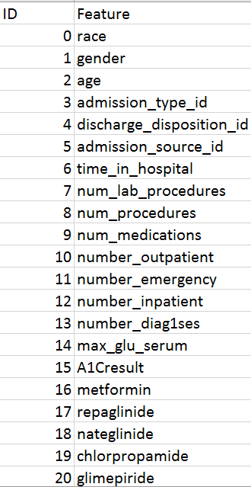
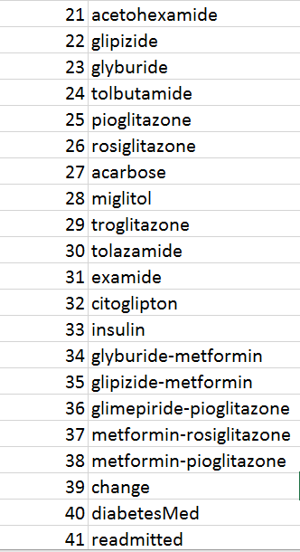
Explorations on Dataset:
Salient Properties–
Feature Scaling- The data needed to be normalized and as a part of the preprocessing stage the range of the independent variables needed to be standardized.
Event though the data wasn’t time series, it was time dependent.

Slide 4
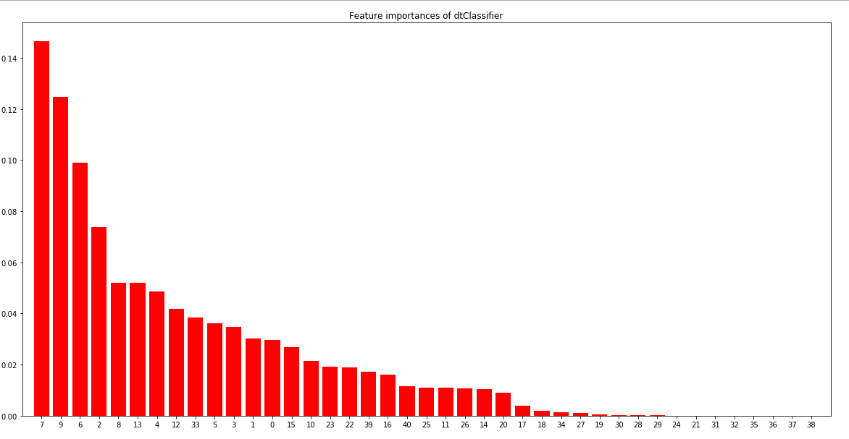
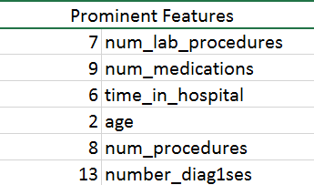
Insights to Predictions :
Model | Accuracy
Decision Tree | 69.12
Random Forest | 71.24
KNN | 57.80
Unweighted Majority Vote Ensemble | 69.89
Summary – Feature 7- num_procedures is predicted to be the most influential factor to cause a hospital readmission. Depending on these predictions hospitals can either perform a through check-up before a patients discharge or might advise patients for a prolonged admission in order to avoid potential readmissions.

